Slide 1
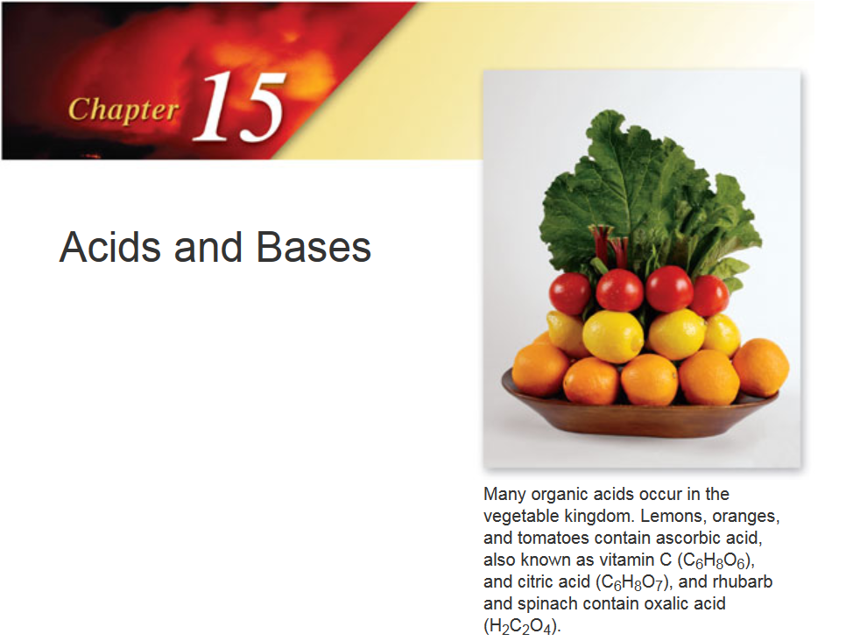

Slide 2


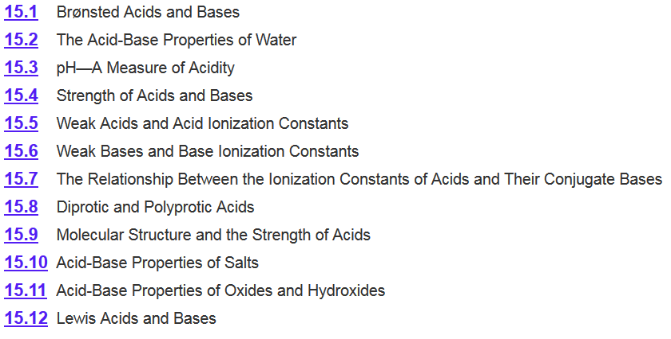
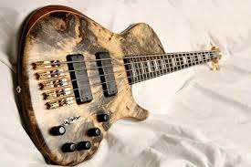
Chapter 15

Slide 3
Acids and Bases: Arrhenius Definition
An acid is a substance that dissociates in water to yield H₃O⁺.
A base is a substance that dissociates in water to yield OH–.
This explains why all neutralization reactions between strong acids and bases and have similar heats of reaction:
H⁺(aq) + OH–(aq) → H₂O(l) ΔH⁰ = -57 kJ/mol

Slide 4
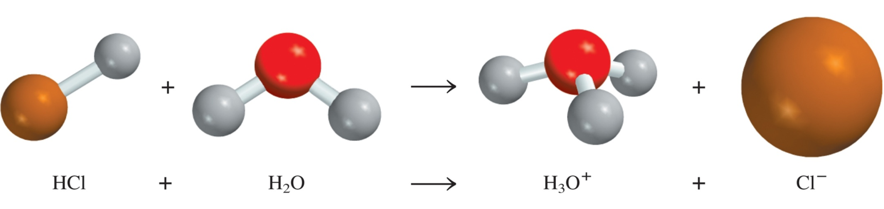
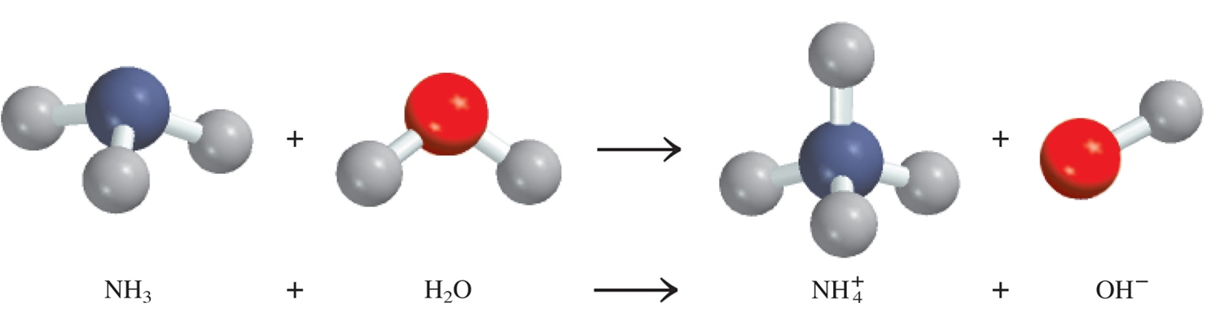
Acids and Bases: Arrhenius Definition
Arrhenius acid is a substance that produces H⁺ (H₃O⁺) in water.
Arrhenius base is a substance that produces OH⁻ in water.
Can something be a base if its not soluble in water?
Brønsted and Lowry proposed a more general definition…

Slide 5

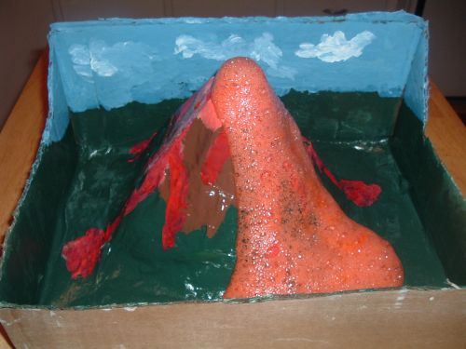
Brønsted Acids
Bronsted Acids- able to donate protons in the form of hydrogen ions – protons – H⁺.
AH A⁻ + H⁺
Typically :
have a sour taste (vinegar-acetic acid, lemons-citric acid)
change the color of litmus from blue to red.
react with carbonates to produce CO₂.
react with metals to produce hydrogen gas.
aqueous acidic solutions conduct electricity
H₃CCOOH_{(aq)} + NaHCO_{3(s)} NaOOCCH_{3(aq)} + CO_{2(g)} + H₂O_{(l)}
2HCl_{(aq)} + Mg _{(s)} MgCl_{2(aq)} + H_{2(g)}
Ch 4.3
Page 127

Slide 6
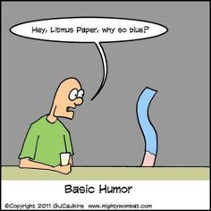
Brønsted Bases
Bronsted Base- able to accept protons in the form of hydrogen ions or H⁺.
B⁻ + H⁺ BH
Typically :
have a bitter taste (antacids-Mg(OH₂)).
change the color of litmus from red to blue.
feel slippery (turns your cells and fat into soap!).
aqueous acidic solutions conduct electricity
Ch 4.3
Page 127

Slide 7


4.3
Classify each of the following species in aqueous solution as a Brønsted acid or base:
HBr
Bronsted Acids- able to donate protons in the form of hydrogen ions – protons – H⁺.
AH A⁻ + H⁺
Bronsted Base- able to accept protons in the form of hydrogen ions or H⁺.
B⁻ + H⁺ BH

Slide 8
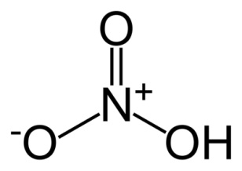
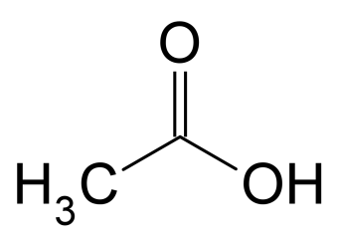
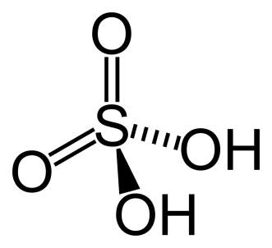
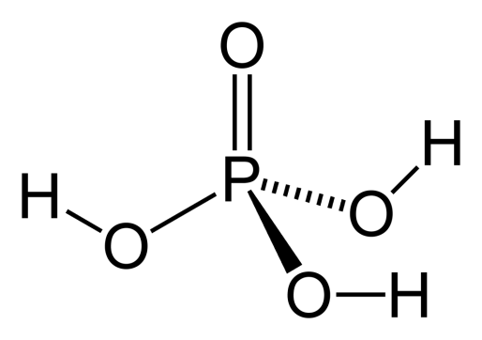
Mono- and Polyprotic Acids
Monoprotic acids
HCl H⁺ + Cl⁻
HNO₃ H⁺ + NO₃⁻
CH₃COOH H⁺ + CH₃COO⁻
Diprotic acids
H₂SO₄ H⁺ + HSO₄⁻
HSO₄⁻ H⁺ + SO₄²⁻
Triprotic acids
H₃PO₄ H⁺ + H₂PO₄⁻
H₂PO₄⁻ H⁺ + HPO₄²⁻
HPO₄²⁻ H⁺ + PO₄³⁻

Slide 9
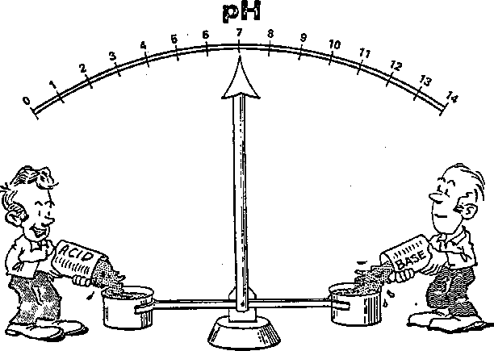
Acid-Base Neutralization
acid + base salt + water
HCl (aq) + NaOH (aq) NaCl (aq) + H₂O
H⁺ + Cl⁻ + Na⁺ + OH⁻ Na⁺ + Cl⁻ + H₂O
H⁺ + OH⁻ H₂O

Slide 10
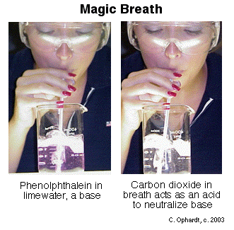
Acid-Base Neutralization
acid + base salt + water + CO₂
2HCl (aq) + Na₂CO₃ (aq) 2NaCl (aq) + H₂O +CO₂
2H⁺ + 2Cl⁻ + 2Na⁺ + CO₃²⁻ 2Na⁺ + 2Cl⁻ + H₂O + CO₂
2H⁺ + CO₃²⁻ H₂O + CO₂

Slide 11
Chapter 15

Slide 12
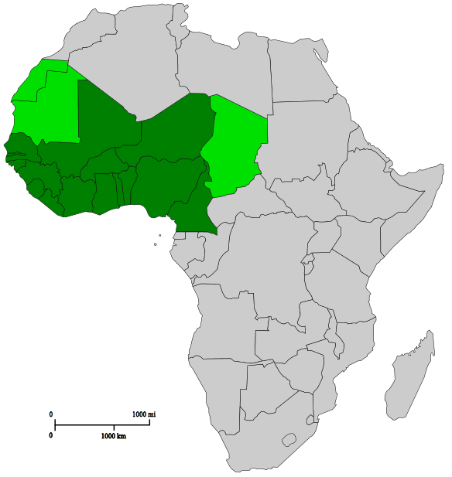
Side note: Acid, Taste and Magic Fruit
Synsepalum dulcificum (AKA Miracle Fruit)
1727- European explorer Chevalier des Marchais
Locals chewed the berries before meals.
Makes bitter/sour things taste sweet

Slide 13
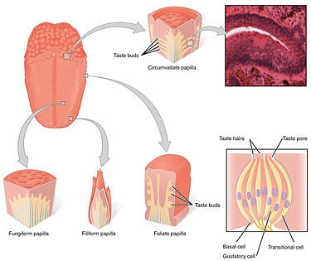
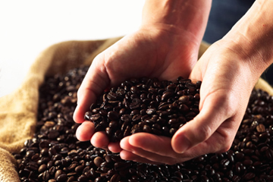
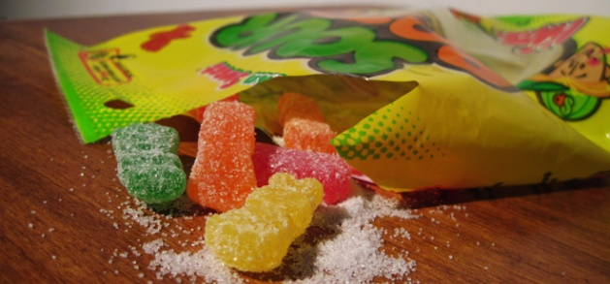
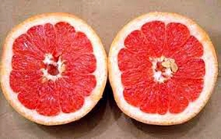
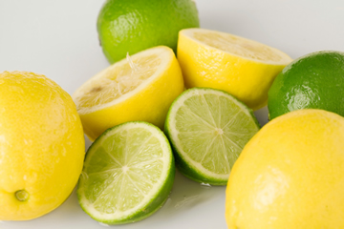
Side note: Acid, Taste and Magic Fruit
Taste Receptors:
Sweet, Sour, Salty, savory and Bitter
(and maybe fat)
All flavors are some combination of these receptor signals
Bitter/sour taste receptors:
- we have identified >50 bitter and sour taste receptors

Slide 14
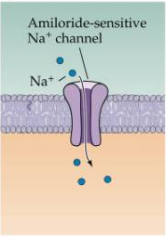
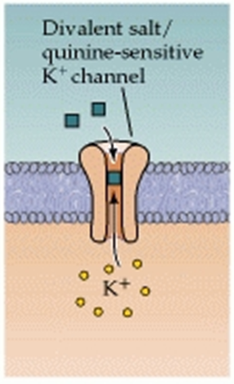
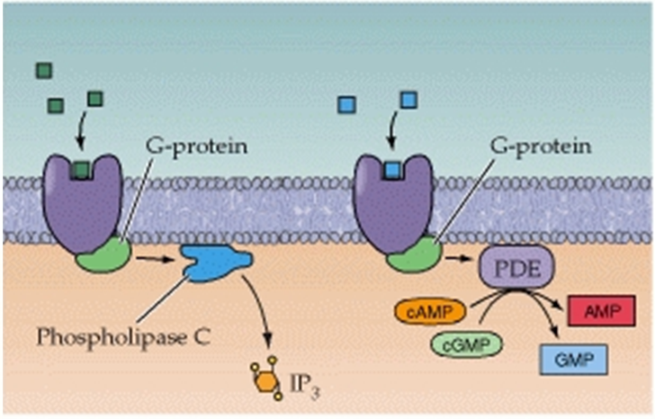
Side note: Acid, Taste and Magic Fruit
Signaling molecules:
Directly signal
Block the channel
Generate signal
Receptor is static (at equilibrium)
Molecule interacts with the protein
Opens/blocks a signaling channel or generates a signaling molecule
Signal causes a discharge pathway that cascades to the brain

Slide 15
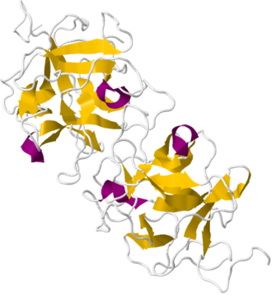
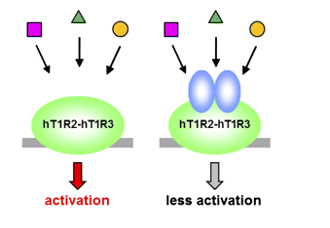
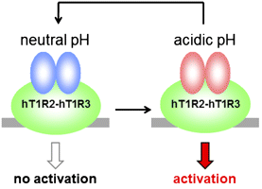
Side note: Acid, Taste and Magic Fruit
Miracle Fruit- Synsepalum dulcificum
Makes bitter/sour things taste sweet
Miraculin- a glycoprotein found in Miracle Fruit that change the structure of taste cell receptors
Sweet receptors are then activated by acid
Signaling molecules
Miraculin
Normal signaling is suppressed.
But it is activated by acid

Slide 16
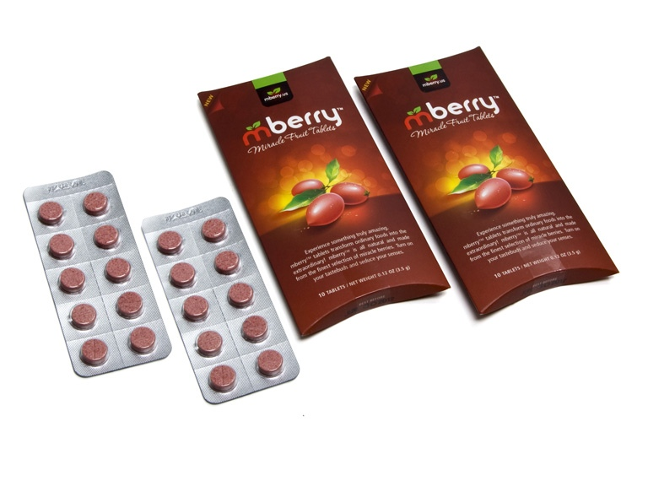
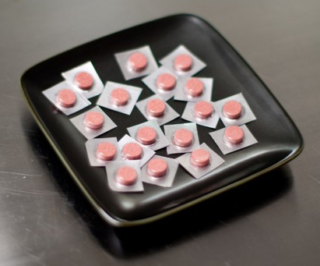
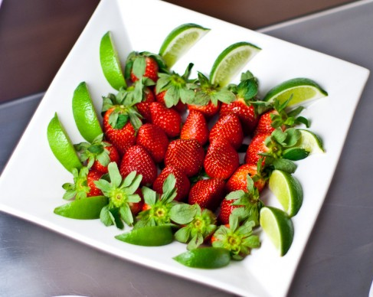
Side note: Acid, Taste and Magic Fruit
Miraculin- a glycoprotein found in Miracle Fruit that change the structure of taste cell receptors
Amazon: 20 pills for $25
Miracle Fruit Party
Medical Applications
Make pills more palatable.
Food for chemo patients.
Competitive sugar substitutes:
1970s- Miralin (CEO Bob Harvey)
sells Miraculin
1970s- Searle (CEO Donald Rumsfeld)
produces aspartame
1974- FDA classifies Miraculin as a food additive, not a food.
1981- FDA approves aspratame for use in food products.

Slide 17
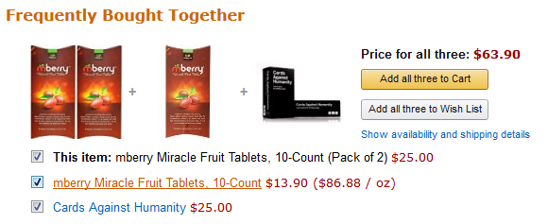
Side note: What?

Slide 18
Chapter 15

